Slide 1
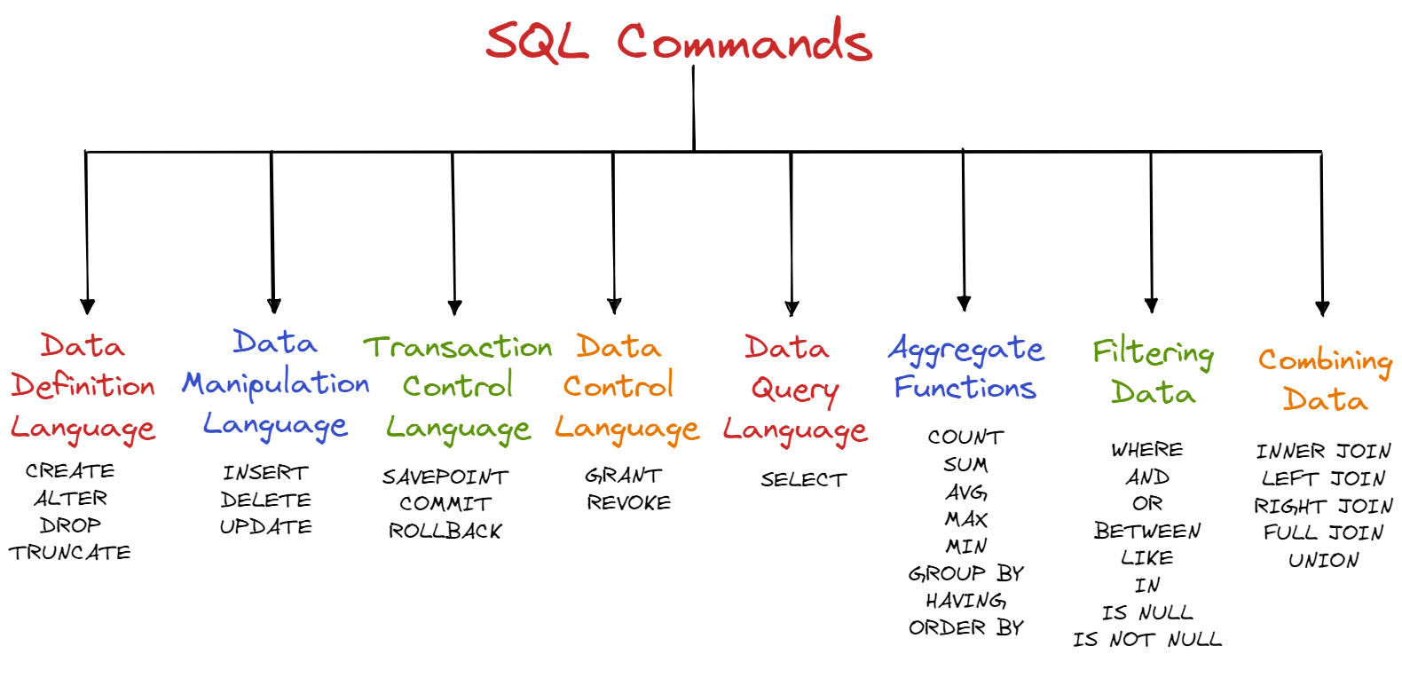
SQL(Structured Query Language):

Slide 2
DDL(Data Definition Language)
Create: is used to create table, database, function, procedures ,constraints etc
Syntax: create database database_name
create table table_name(column1 datatype,column2 datatype(size))
Rules to create table :
to create table at least one column is required
In sql server table name or column name should not start with digits
Table name or column name should not be two parts

Slide 3
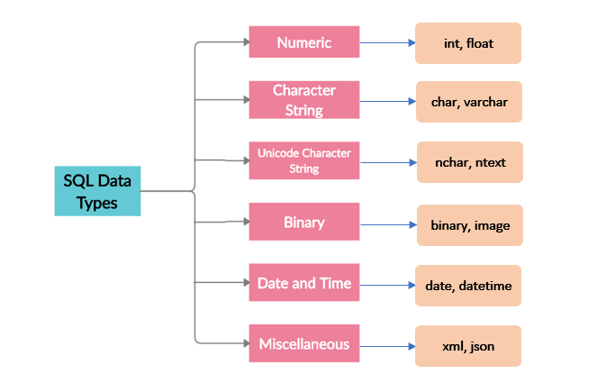
SQL Data Types
for more details click here

Slide 4
drop:
is used to drop the database or table or any thing permanently.
to drop database: drop database database_name
to drop table : drop table table_name
to drop column : alter table table_name
drop column column_name

Slide 5
alter:
is used to modify the table structure like add column, drop column or change column datatype or its size
Ex:
alter table emp
add address varchar(20)
alter table emp
drop column address

Slide 6
truncate
using truncate we can only delete all records from table
truncate table table_name

Slide 7
update:
is used to modify the table data or content or record
to modify the record: update emp set name='manoj' where id=1
delete:
is used to delete the data from the table
to delete one record : delete from emp where id=1
to delete all records : delete from emp

Slide 8
Difference:
In SQL, the difference between "DROP," "DELETE," and "TRUNCATE" is as follows:
"DROP" is used to remove an entire table or a database from the database system. Once a table or database is dropped, all the data stored in it is lost and cannot be recovered.
"DELETE" is used to remove specific rows from a table. The deleted rows can be retrieved using the "ROLLBACK" command.
"TRUNCATE" is used to remove all rows from a table. The truncated data cannot be retrieved. This is faster than deleting rows one by one, especially for large tables.

Slide 9
Data Transaction Language:
rollback: rollback is used to cancel the transaction (undo)
begin transaction
delete from emp where id=1
rollback
commit: commit is used to make the transaction as permanent.
begin transaction
delete from emp where id=1
commit

Slide 10
BEGIN TRANSACTION
The "BEGIN TRANSACTION" statement is used to start a new transaction. A transaction is a sequence of one or more SQL statements that are executed as a single unit of work.
This means that all the statements within a transaction are executed together, and if any statement fails, the entire transaction is rolled back, and the database is returned to its state before the transaction began.
BEGIN TRANSACTION;
INSERT INTO Customers (Name, Address) VALUES ('John', '1234 Main St’);
UPDATE Orders SET Quantity = Quantity + 10 WHERE OrderID = 100;
COMMIT;
In summary, BEGIN TRANSACTION statement starts a new transaction, it is used to execute one or more SQL statements as a single unit of work. The transaction can be committed with COMMIT statement or rollbacked with ROLLBACK statement.

Slide 11
Save point
Save point is used to save the transaction. "SAVEPOINT" is a point within a transaction where the state of the database can be saved. This allows you to undo part of a transaction without rolling back the entire transaction.
begin transaction
save transaction t1
delete from emp where id=2
save transaction t2
delete from emp where id=3
save transaction t3
delete from emp where id=4

